Slide 1
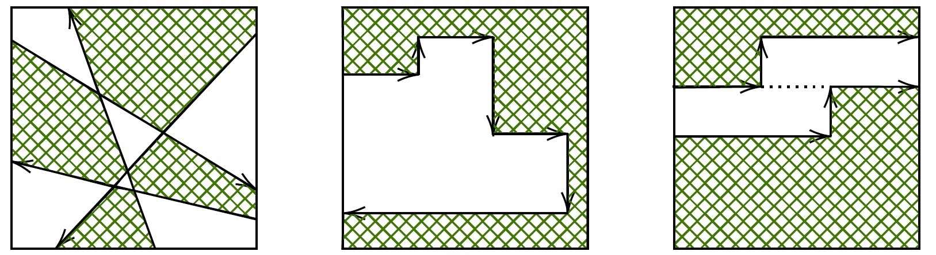
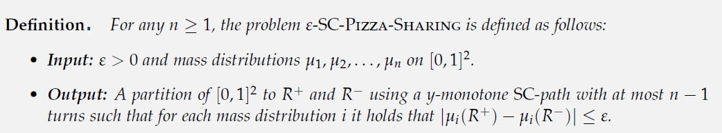
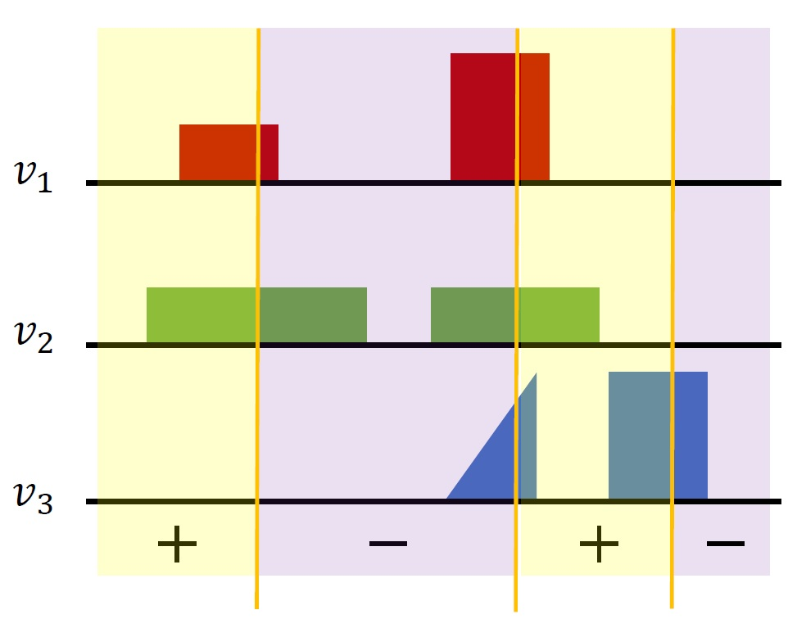
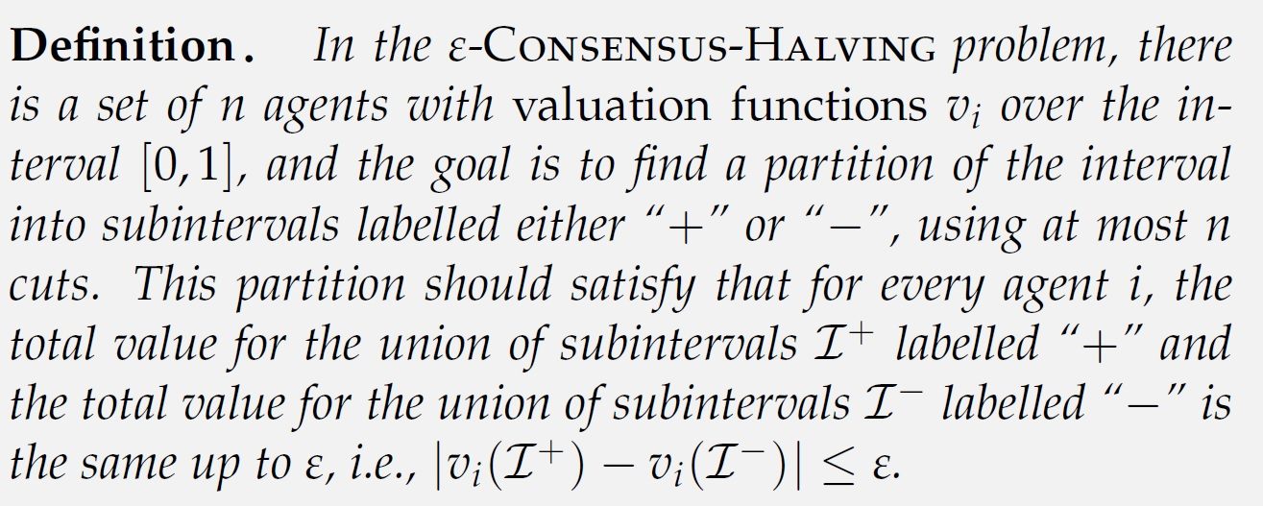
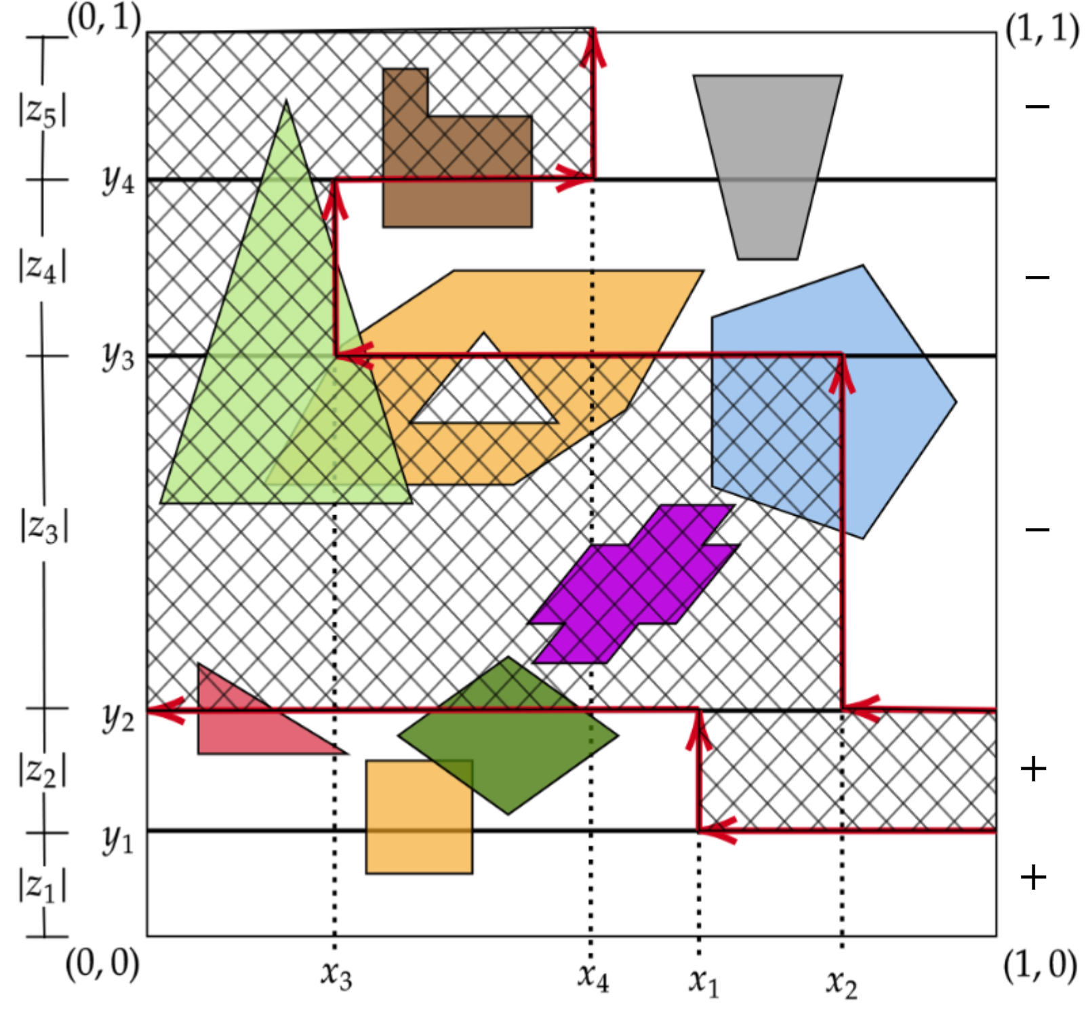
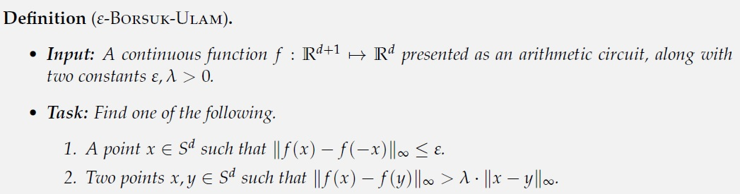
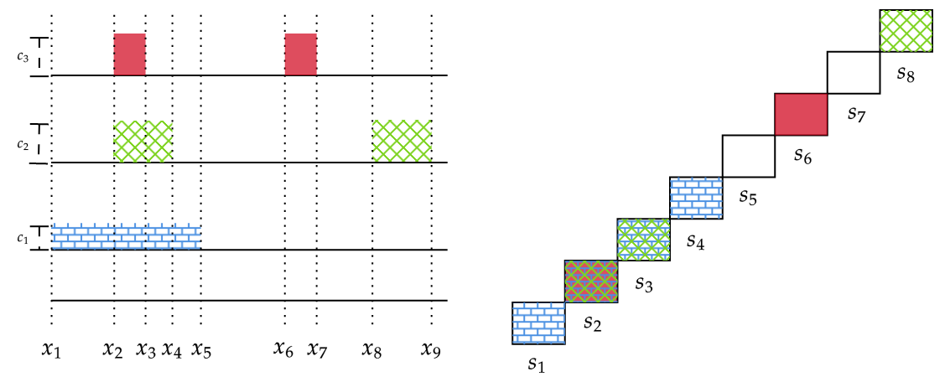

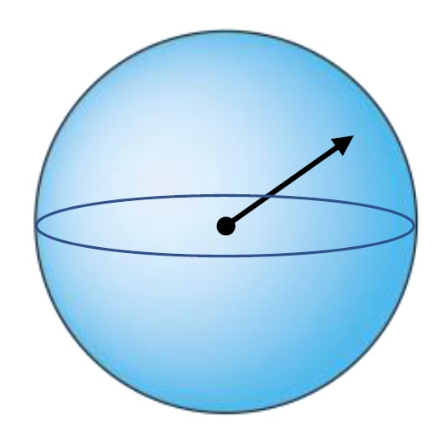

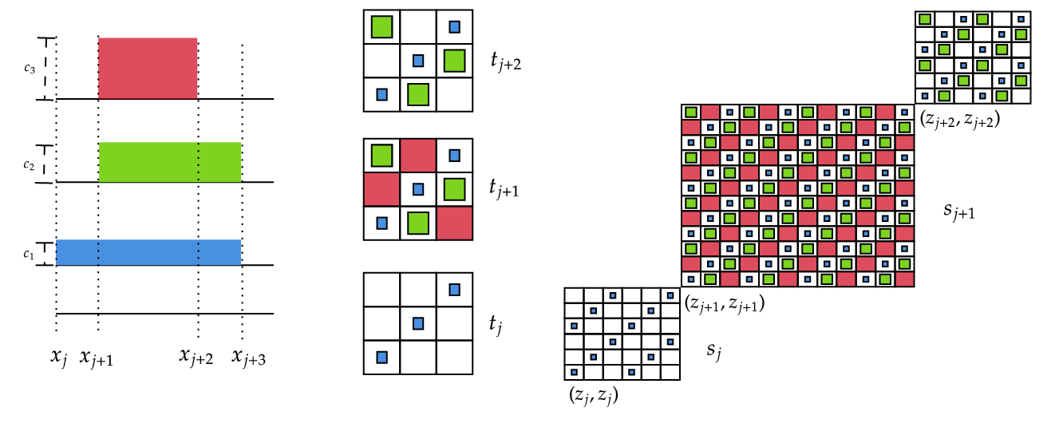
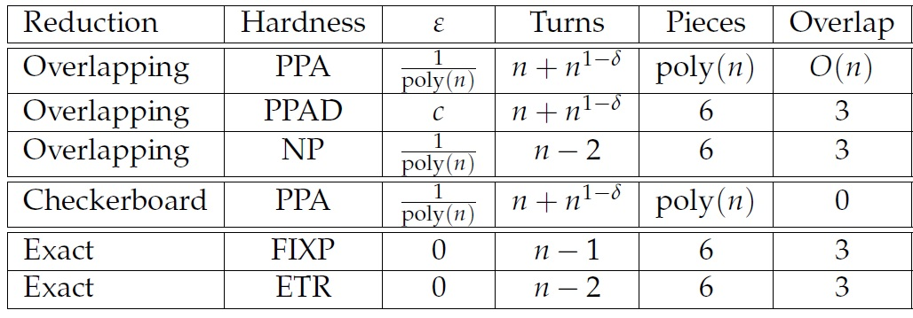
Square-Cut Pizza Sharing is PPA-complete
Argyrios Deligkas John Fearnley Themistoklis Melissourgos
Royal Holloway University of London University of Liverpool Technical University of Munich
ε-SC-Pizza-Sharing is PPA-hard | exact SC-Pizza-Sharing is FIXP-hard
ε-SC-Pizza-Sharing is in PPA | exact SC-Pizza-Sharing is in BU
The “overlapping” reduction
We reduce from instances of [1, 2, 3, 4]
Create square blocks according to points of interest
Each pizza block is a square consisting of perfectly overlapping masses of identical shape (square)
Each colour in a pizza block has its own weight depending on its density (height) in the CH instance
(original proof by [5])
The “checkerboard” reduction
Open problems
Detailed hardness results
We reduce from instances of [4]
Again, create blocks according to points of interest
The masses are unweighted and non-overlapping
Each pizza block is diagonally filled in with small masses (squares)
Each colour in a pizza block has area proportional to its density (height) in the CH instance
This reduction does not work for the exact SC-Pizza-Sharing!
What is the complexity for const. ε? PPAD-, PPA-complete?
What is the complexity of exact SC-Pizza-Sharing with axis-aligned rectangles? PPA-, FIXP- or BU- complete?
What is the complexity of exact version for polygons? FIXP- or BU-complete?
References
[1] Deligkas, Fearnley, Melissourgos, Spirakis. Computing exact solutions of consensus halving and the Borsuk-Ulam theorem. 2021
[2] Filos-Ratsikas, Frederiksen, Goldberg, Zhang. Hardness results for consensus-halving. 2018
[3] Filos-Ratsikas, Goldberg. The complexity of splitting necklaces and bisecting ham sandwiches. 2019
[4] Filos-Ratsikas, Hollender, Sotiraki, Zampetakis. Consensus-halving: Does it ever get easier? 2020
[5] Karasev, Roldán-Pensado, Soberón. Measure partitions using hyperplanes with fixed directions. 2016

